Slide 1
AtliQ Hospitality Analysis - Unified mentor
Katuri Madhava Rajesh

Slide 2
Introduction:
Atliq Grands, a renowned chain of five-star hotels in India, is facing declining market share and revenue due to competition and ineffective management decisions. To address this, they are leveraging Business and Data Intelligence to gain insights from historical data and develop strategies to reclaim their market position.

Slide 3
Details of data:
We analyzed five datasets:
dim_date
dim_hotels
dim_rooms
fact_aggregated_bookings
fact_bookings
These datasets include information on hotel properties, room categories, booking details, and dates, providing a comprehensive view of the hotel's operations and customer behavior.

Slide 4
Main KPI’s:
Revenue: Total and realized revenue generated by hotel bookings.
Occupancy Percentage: The ratio of successful bookings to total room capacity.
Average Ratings: Customer satisfaction ratings for hotel services.
Booking Distribution: Analysis of booking status, platforms, and trends.
City and Property Performance: Revenue split by city and individual hotel properties.

Slide 5
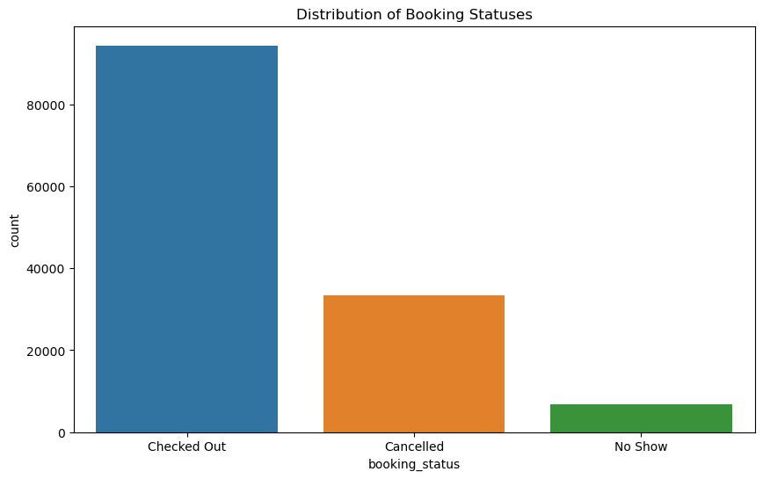
Distribution of Booking Statuses

Slide 6
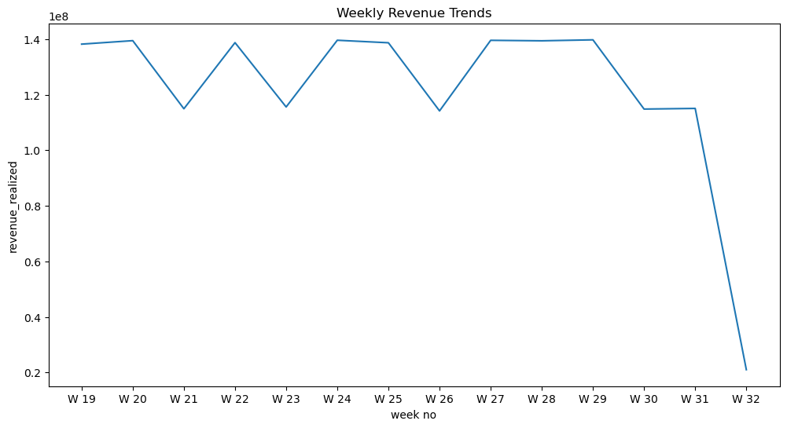
Weekly Revenue Trends:

Slide 7
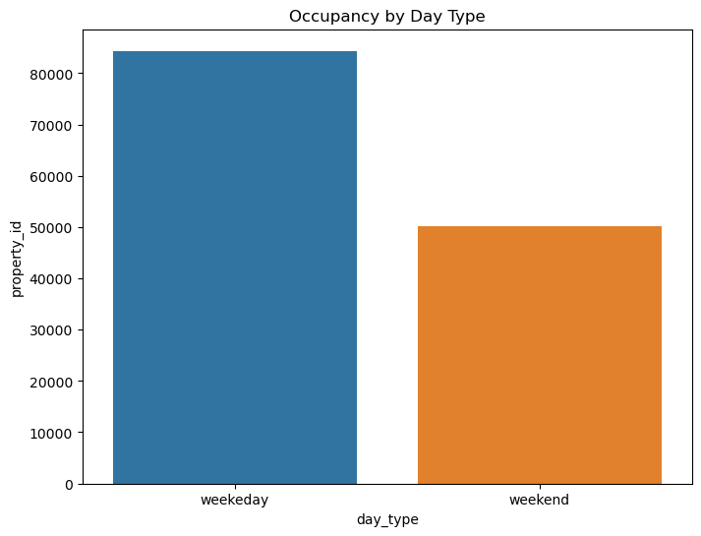
Occupancy by Day Type:

Slide 8
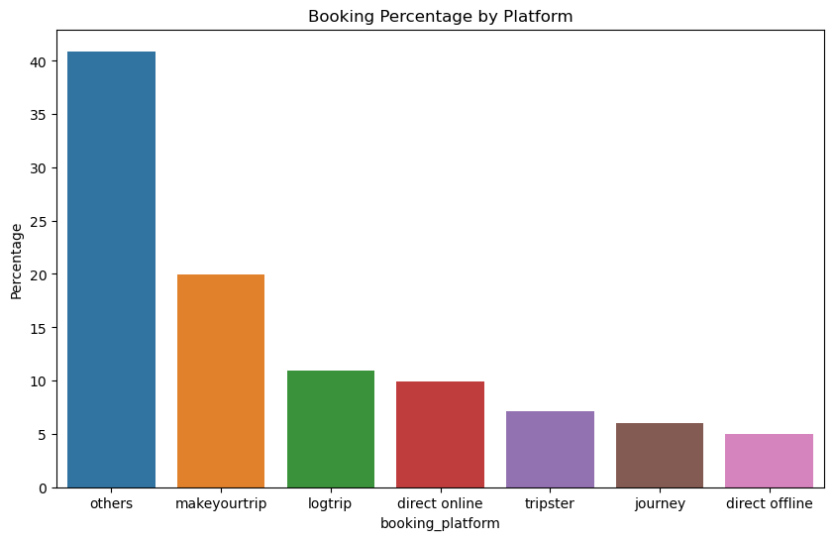
Booking Percentage by Platform:

Slide 9
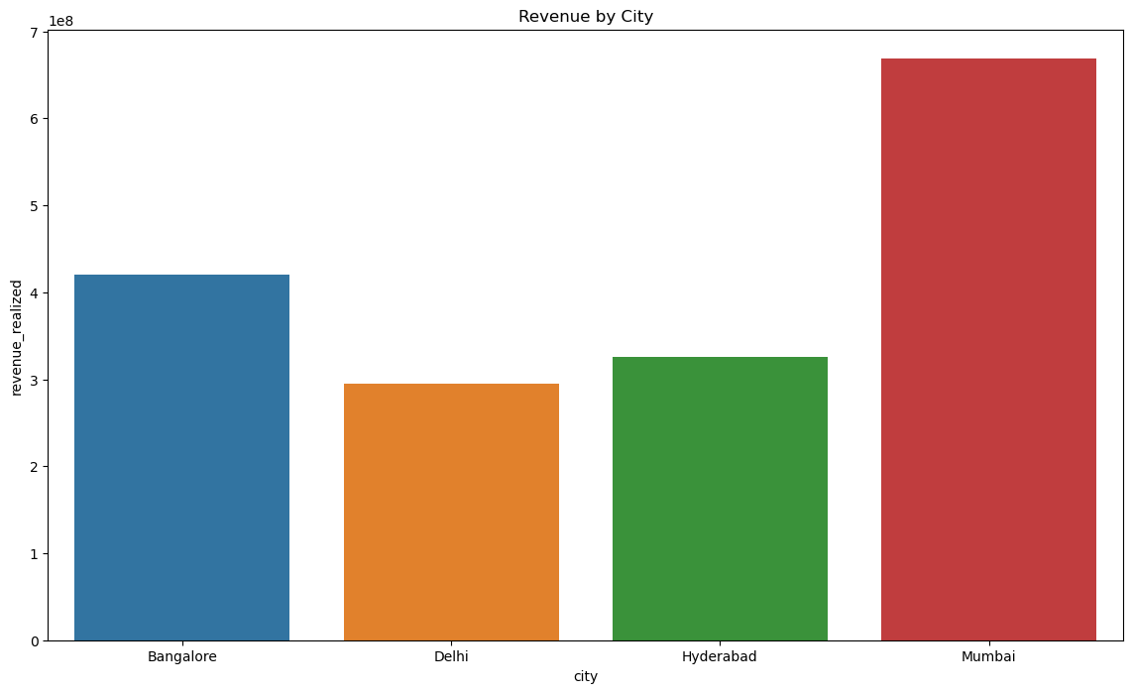
Revenue by City:

Slide 10
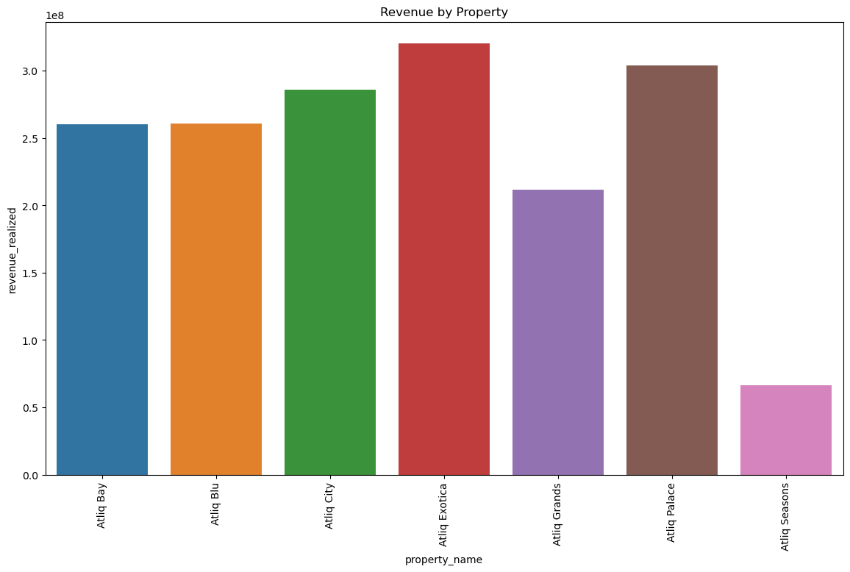
Revenue by Property:

Slide 11
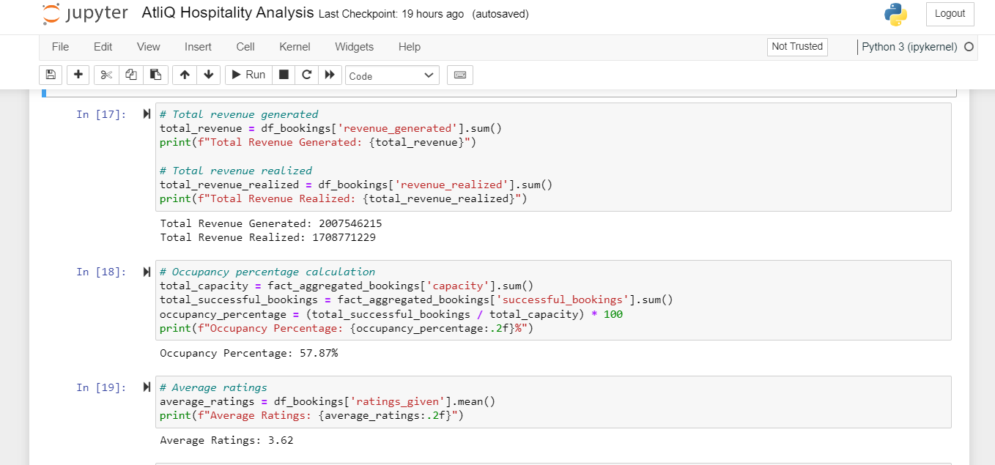
Revenue generated and realized:

Slide 12
THANK YOU

